Slide 1
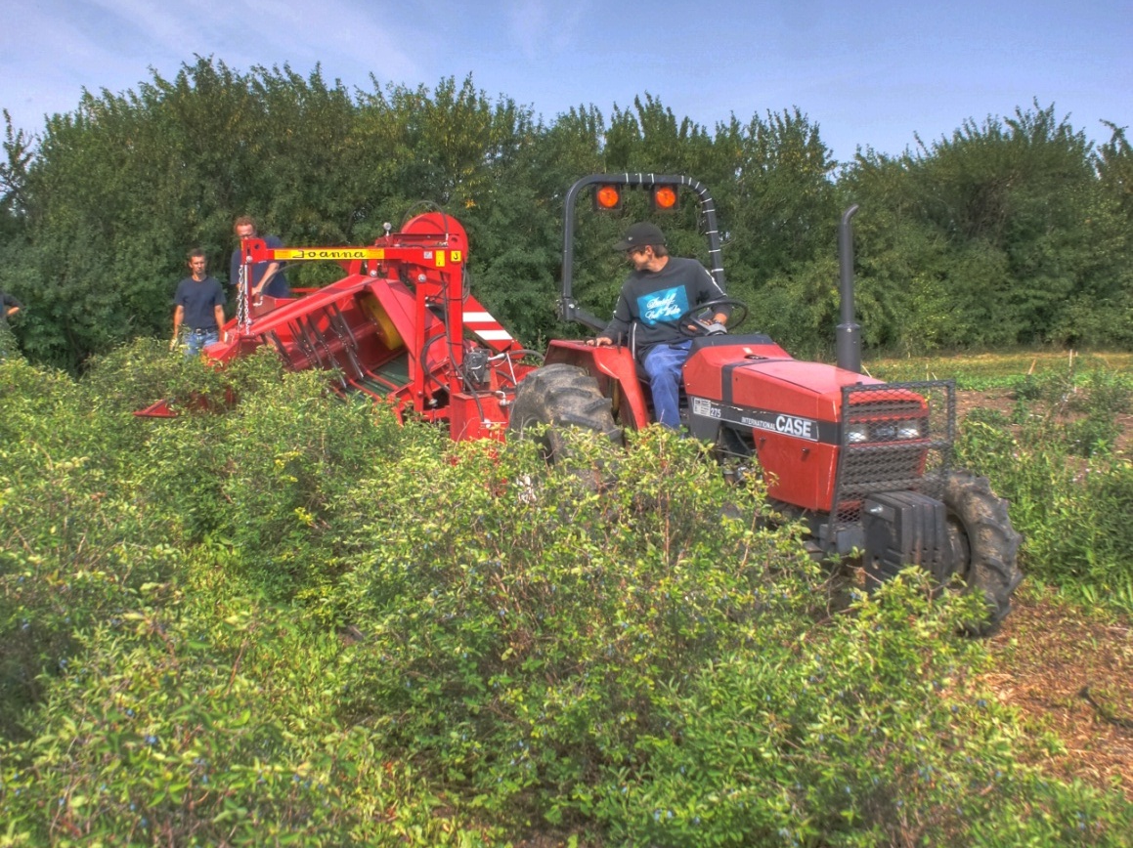
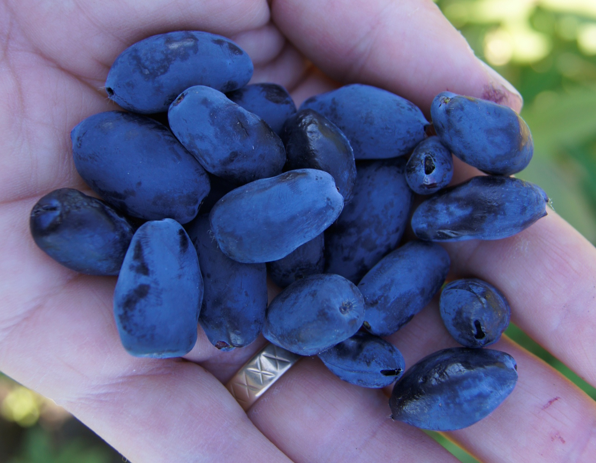
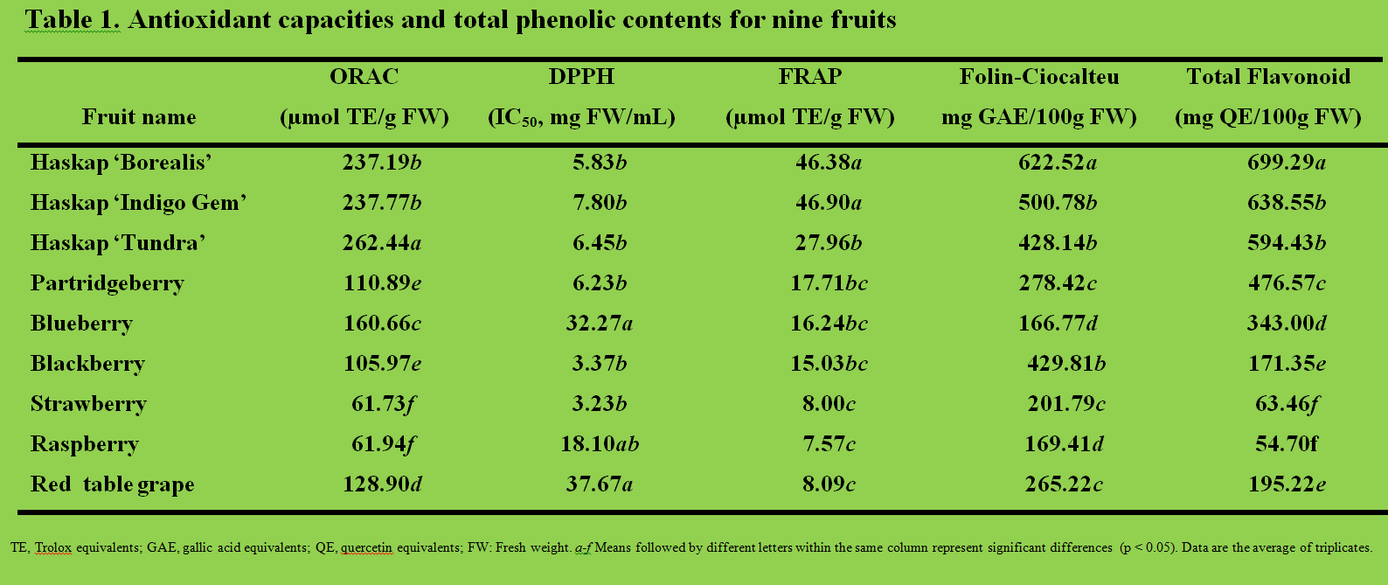
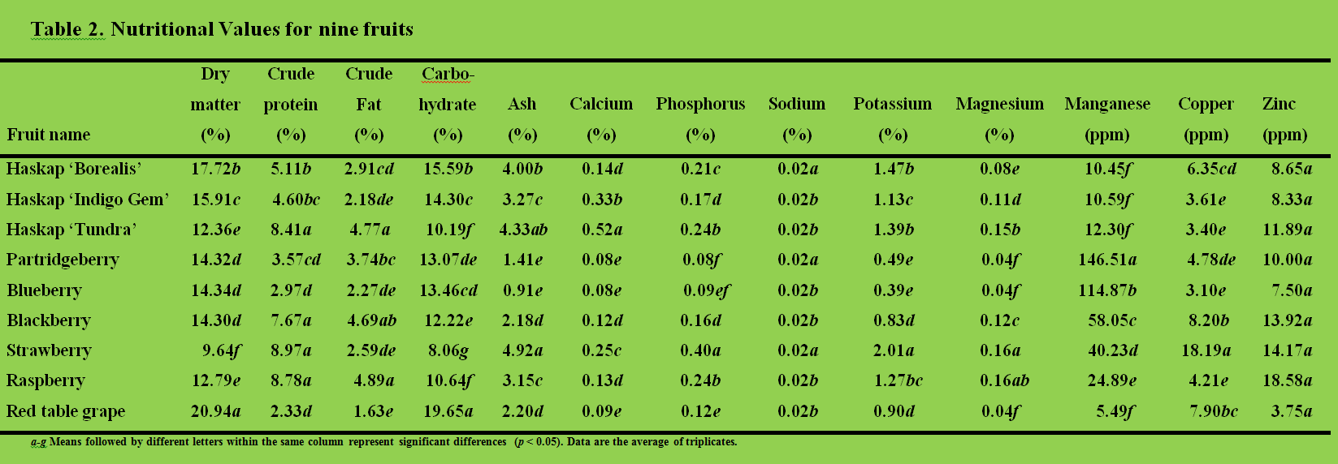
Haskap: A New Berry Crop with High Antioxidant Capacity
Li Juan Yu,¹ Khushwant Bhullar¹ and H. P. Vasantha Rupasinghe^{1*} and Bob Bors²
¹: Department of Environmental Sciences, Nova Scotia Agricultural College, Truro, Nova Scotia, B2N 5E3, Canada
²: Department of Plant Sciences, University of Saskatchewan, Saskatoon, S7N 5A8, Canada
Abstract
This study evaluated the antioxidant capacity, total phenolic content and total flavonoid content of three haskap cultivars, ‘Borealis’, ‘Indigo Gem’ and ‘Tundra’ grown in Saskatchewan with comparison to six other commercial fruits. The results indicated that haskap berries, especially cv. ‘Borealis’ possessed the highest antioxidant capacities and total phenolic contents, specifically total flavonoid among tested fruits and could be used as a promising fruit source of natural antioxidants. The nutritional values of the fruits were also assessed using proximate analysis. Strawberry possessed the highest amount of most minerals and nutrients whereas the nutritional values for the three haskap cultivars were among the average.
Introduction
Haskap (Lonicera caerulea), also called ‘blue honeysuckle’, ‘honeyberry’ and ‘sweet berry honeysuckles’, is a relatively new berry crop to Canada (Bors, 2009) and is a fruit with unique flavor, aroma and nutritional characteristics (Skupien et al., 2009; Lewis 2011). In Canada, there are three major haskap varieties being widely planted: ‘Borealis’, ‘Indigo Gem’ and ‘Tundra’; all were bred at the University of Saskatchewan. The major classes of phenolics present in haskap are flavonols (quercetin glycosides), flavin-3-ols (catechin and proanthocyanindins), anthocyanins (cyanidin glucoside) and phenolic acids (salycil acid, coumaric acid, gentistic acid) (Skupien et al., 2009; Jurikova et al., 2012). The objective of this study was to compare the antioxidant capacity, total phenolic content, total flavonoid content and general basic value of haskap berries from recently released Haskap varieties with selections of six other berry crops. Lonicera caerulea of unknown origin had been found high in bioactive compounds compared to wild fruits in western Canada (Bakowska-Barczak et al., 2007) but this is the first study comparing haskap cultivars being grown commercially in Canada with mainstream berry crops.
Materials and Methods
Haskap fruit was obtained from the U. of Sask. Fruit Program. Other fruit was purchased locally in Truro, NS. The Folin-Ciocalteu assay was performed to estimate the total phenols (Singleton and Rossi, 1965) and modified by Rupasinghe et al. (2010). Determination of total flavonoid content was done by a modified aluminum chloride colorimetric method based on Marinova et al (2005). The ferric reducing antioxidant power (FRAP) assay was used to determine the electron donating potential of the fruit samples (Benzie and Strain, 1996; Rupasinghe et al. 2010). The hydrophilic oxygen radical absorbance capacity (ORAC) assay was based on Huang et al. (2002). The free radical scavenging activity of fruit polyphenols was measured using the method described by Brand-Williams et al. (1995) and modified by Lu and Foo (2000). Various nutritional levels were also analysed. Statistical analysis used ANOVA, the general linear model, with SAS System version 9.2 for Windows. Mean separations were examined using Tukey’s Student range test (t-test). Significant differences were compared using a p-value of 0.05.
Figure 1. New Haskap varieties have been released that can be mechanically harvested (above) and have excellent flavour. ‘Indigo Gem’s ‘fruit (below) is similar in size and appearance to ‘Borealis’ and ‘Tundra’.
Results & Discussion
Three haskap cultivars, namely ‘Borealis’, ‘Indigo Gem’, ‘Tundra’ had the strongest antioxidant capacities among nine tested fruits based on a combinative consideration of the results obtained by FRAP and ORAC assays as well as the aluminum chloride colorimetric method and the Folin–Ciocalteu method. Especially, haskap ‘Borealis’ consistently gave the strongest antioxidant capacities, the highest total phenolic content and the highest total flavonoid content. It could therefore be expected that the new Haskap ‘Borealis’ could be considered as a cultivar for developing value-added food products and natural health products for preventing the chronic diseases caused by oxidative stress (Li et al. 2012).
. However, the nutritional values such as mineral contents of the three haskap fruits were among the average of the nine fruits. The results of this study suggest that this recently introduced berry crop in Canada could be considered as one of the fruits with highest antioxidant capacity in vitro. These three haskap varieties are full sibs, yet in most tests done there were significant differences between varieties. This species is tetraploid and an obligate outcrosser, which could account for some of this variability. A morphological difference between varieties is that ‘Borealis’ has a dense canopy that usually hides berries from plain view
and may result in less sunlight directly reaching the berries (Bors 2012).
Further investigations are warranted for understanding the heath promoting properties of haskap bred and grown in Canada . Such research has the potential for developing unique functional foods and natural health products.
References
Bakowska-Barczak, A. M., Marianchuk, M. and Kolodziejczyk P. 2007. Survey of bioactive components in Western Canadian berries. Can. J. Physiol. Pharmacol. 85: 1139–1152.
Benzie, I. and Strain, J. 1996. The ferric reducing ability of plasma (FRAP) as a measure of “antioxidant power”: the FRAP assay. Anal. Biochem. 239: 70-76.
Bors, B. 2009. Breeding of Lonicera caerulea L. for Saskatchewan and Canada. . Proceedings of the 1st Virtual International Scientific Conference on Lonicera caerulea L. Sponsored by Russian Academy of Agricultural Sciences, Ministry of Agriculture, All-Russian Horticulturae Michurin Institute. 88-98.
Bors, B., Thomson, J., Sawchuk,E., Reimer, P., Sawatzky, R. and Sander, T. 2012. Haskap breeding and production final report. Saskatchewan Agriculture ADF2008-0042. 142pgs.
Brand-Williams, W., Cuvelier, M. E. and Berset, C. 1995. Use of a free radical method to evaluate antioxidant activity. LWT-Food Sci Tech, 28: 25-30.
Huang, D., Ou, B., Hampsch-Woodil, M., Flanagan, J. and Prior, R. 2002. High-throughput assay of oxygen radical absorbance capacity (ORAC) using a multichannel liquid handling system coupled with a microplate fluorescence reader in 96-well format. J. Agric Food Chem. 50: 4437-4444.
Jurikova, T., Rop, O., Mlcek, J., Sochor, J., Balla, S., Szekeres, L., Hegedusova, A., Hubalek, J., Adam, V., and Kizek, R. 2012. Phenolic profile of edible honeysuckle berries (Genus Lonicera) and their biological effects. Molecules. 17:61-79.
Lewis, J. 2011. Is Haskap for you? http://www.atlanticfarmfocus.ca [2012 Jan.13].
Lu, Y. and Foo, L.Y. 2000. antioxidant and radical scavenging activities of polyphenols from apple pomace. Food Chem. 68: 81-85.
Marinova, D., Ribarova, F. and Atanassova, M. 2005. Total phenolics and total flavonoids in Bulgarian fruits and vegetables. Journal of the University of Chemical Technology and Metallurgy, 40: 255-260.
Rupasinghe, H.P.V. 2008. The Role of Polyphenols in Quality, Postharvest Handling, and Processing of Fruits. Postharvest Biology and Technology of Fruits, Vegetables and Flowers (Ed.) Paliyath, G., Murr, D.P., Handa, A.K., and S. Lurie, S. Blackwell Publishing. pp. 260-281.
Rupasinghe, H. P. V., Huber, G. M., Embree, C. G. and Forsline, P. L. 2010. Red-fleshed apple as a source for functional beverages. Can J. Plant Sci. 90: 95-100.
Singleton, V. and Rossi, J. 1965. Colorimetry of total phenolics with phosphomolybdic-phosphotungstic acid reagents. Am. J. Enol. Viticul. 16: 144-158.
Skupien, K., Ochmian, I. and Grajkowski, J. 2009. Influence of ripening time on fruit chemical composition of two blue honeysuckle cultivars. J. Fruit Oranamental Plant Res. 17: 101-111.
ACKNOWLEDGEMENTS
This research was funded by Nova Scotia Economic & Rural Development (NSERD) program and Saskatchewan’s Agriculture Development Fund.

